Slide 1
Unit testing
Gary Bowerbank, Csaba Riedlinger

Slide 2
Contents
Unit testing, examples
Recommended format, content
Storage options

Slide 3
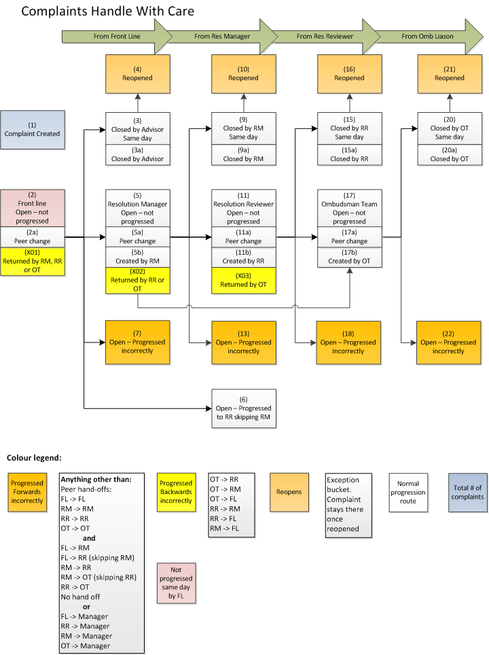
HWC

Slide 4
Unit test examples
What is a unit?
Individual units of source code
Isolated code fragments
Smallest testable piece of an application
Sub-query factoring (Ex1)
Smaller or bigger units? (Ex11, Ex12)

Slide 5
Unit test examples
What is a unit?
Individual units of source code
Isolated code fragments
Smallest testable piece of an application
Sub-query factoring (Ex1)
Smaller or bigger units? (Ex11, Ex12)
Test data
Select from
DUAL
HDS
Source table (Ex2)
Mock up table (Ex3)

Slide 6
Recommended format, content
Unit test file (view_name.ut.sql) – single vs. multiple files (Ex4)
Header – similar to view/procedure/package
Created when, by who, what purpose, modified by, change history

Slide 7
Recommended format, content
Unit test file (view_name.ut.sql) – single vs. multiple files (Ex4)
Header – similar to view/procedure/package
Created when, by who, what purpose, modified by, change history
Test data setup section
Scenarios, supporting columns,
Expected results, outcomes (PL/SQL wrapper?) (Ex5)

Slide 8
Recommended format, content
Unit test file (view_name.ut.sql) – single vs. multiple files (Ex4)
Header – similar to view/procedure/package
Created when, by who, what purpose, modified by, change history
Test data setup section
Scenarios, supporting columns,
Expected results, outcomes (PL/SQL wrapper?) (Ex5)
Clear down test data, then
repeat with real data
repeat with garbage data (we can’t cater for all cases)

Slide 9
Recommended format, content
Unit test file (view_name.ut.sql) – single vs. multiple files (Ex4)
Header – similar to view/procedure/package
Created when, by who, what purpose, modified by, change history
Test data setup section
Scenarios, supporting columns,
Expected results, outcomes (PL/SQL wrapper?) (Ex5)
Clear down test data, then
repeat with real data
repeat with garbage data (we can’t cater for all cases)
Unit test log (view_name.ut.log) (Ex4)
When, who, what
Normal scenarios and exceptions
Duplicate testing
Incremental updates, multi-day runs
Explain plan

Slide 10
Storage options
Shared drive
Same structure as Dimensions
Final code, unit test and log file kept together
Separate sub-directories may be used for test data, mock-up objects, finalised code
Database
Stored in a CLOB
Maintained by an APEX app

Slide 11
Storage options
Dimensions
Use structure implemented for Test Driven Development (TDD)
Folder can be set up by DBAs as required
Separate folder for test data scripts, logs, results, packages etc.
Option to have another thread for third party apps (e.g. PLUNIT)

Slide 12
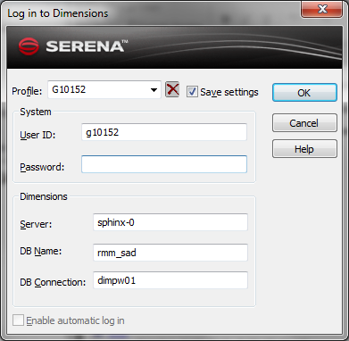
Screenshots

Slide 13
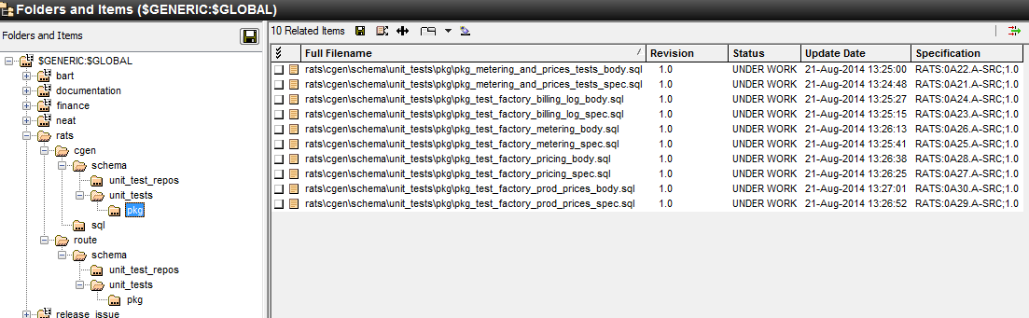
Screenshots

Slide 14
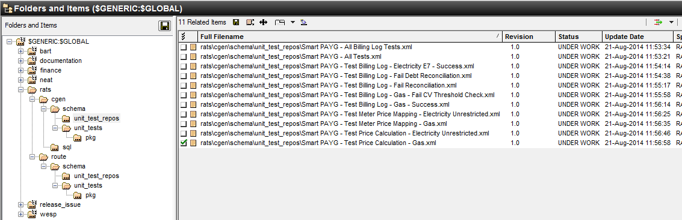
Screenshots

